Slide 1

Walchand College of Engineering ,Sangli
An Autonomous Institute
Building a SQL-based data warehouse for a trillion rows in Python
Submitted By
2018BTECS00212
2018BTECS00211
2017BTECS00068
Guided by
Dr.B F Momin

Slide 2

Example
PRODUCT
product_id
product_name
product_price
EMPLOYEE
emp_id
emp_name
emp_region
SALES
product_id
order_id
customer_id
emp_id
total
CUSTOMER
customer_id
customer_name
Notes:
https://medium.com/everoad/building-a-data-warehouse-in-six-months-what-did-we-learn-e058e42446f1

Slide 3
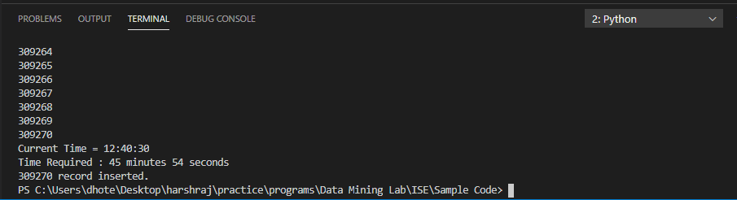
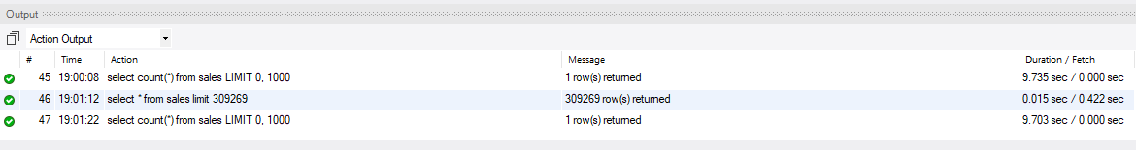
Operation Statistics (Using Python)
There are about 30M seconds in a year; 86,400 seconds per day.
Inserting 30 rows per second becomes a billion rows per year.
Notes:
https://medium.com/everoad/building-a-data-warehouse-in-six-months-what-did-we-learn-e058e42446f1

Slide 4
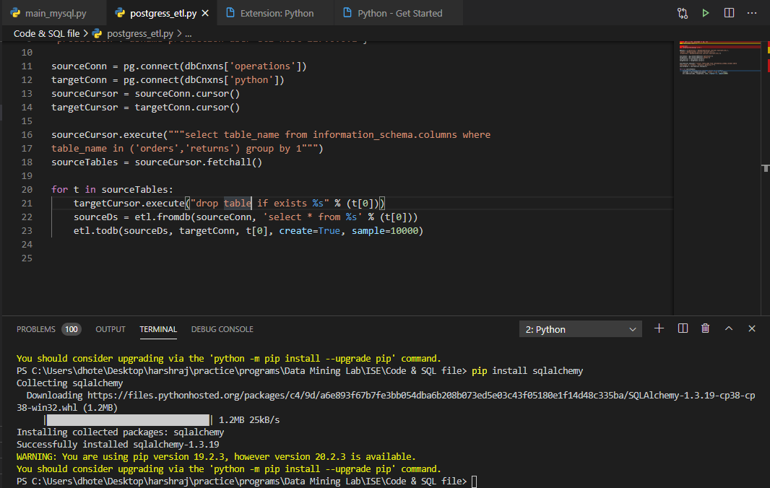

Slide 5
Python ETL Tools
Petl
Pandas
Mara
Airflow
Spark

Slide 6
Data warehouse stages
Staging Layer
Core Layer
Semantic Layer

Slide 7
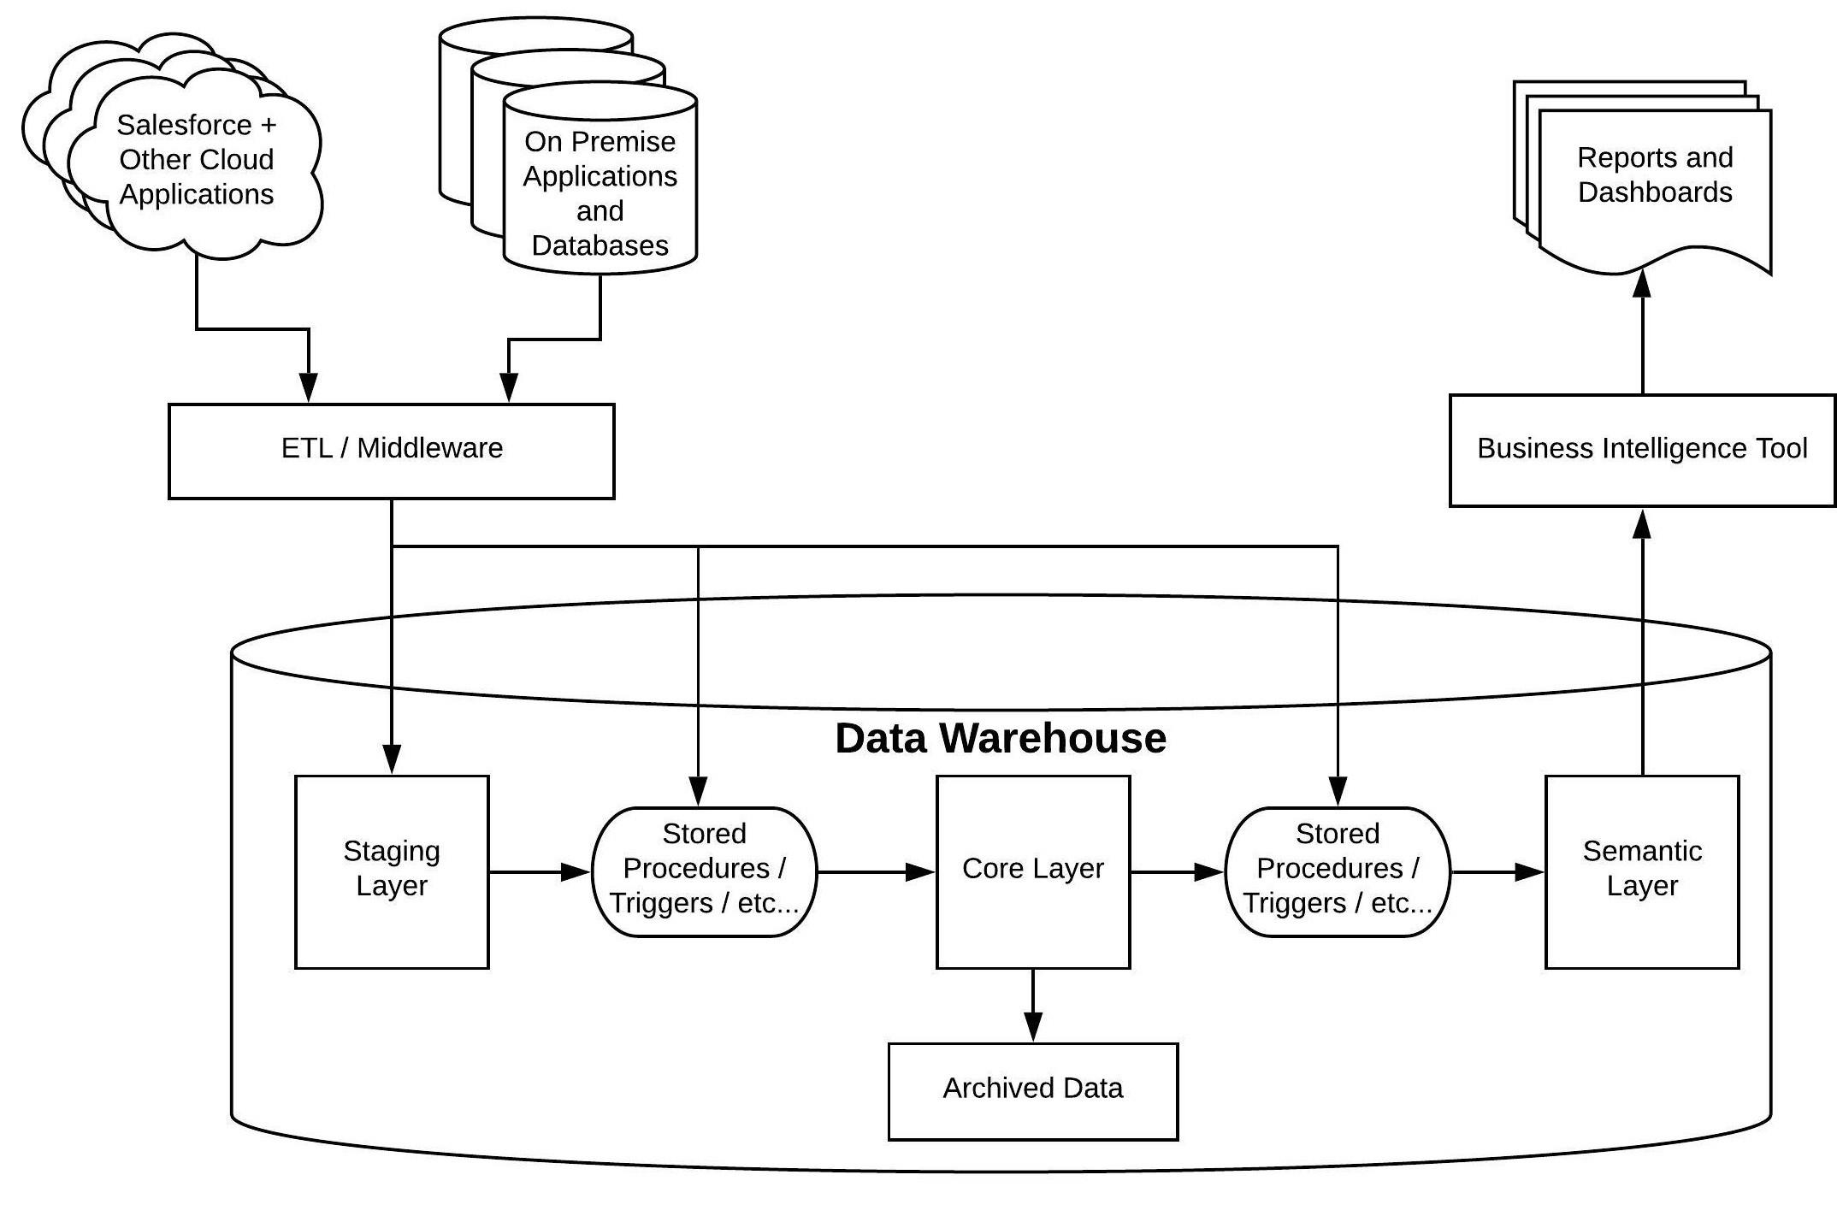
Notes:
https://medium.com/salesforce-architects/steps-to-build-a-scalable-data-warehouse-architecture-a2a8a65bac80

Slide 8
Data warehouse conceptions
First, we should use a BRIDGE level
Second, we find a CLOUD level
Third, we have LAKES
Then, we use VIZ objects
Notes:
https://medium.com/everoad/building-a-data-warehouse-in-six-months-what-did-we-learn-e058e42446f1

Slide 9
Building scalable warehouse
High availability
Excellent system performance
Easy to scale out

Slide 10
How to achieve best design ?
Sharding
Proxy
Multi Node Cluster
Storage
Efficient Retrieval
Load Balancing
Cache
Notes:
For storage speak about matrix
https://medium.com/datadriveninvestor/complete-data-analytics-solution-using-etl-pipeline-in-python-edd6580de24b

Slide 11
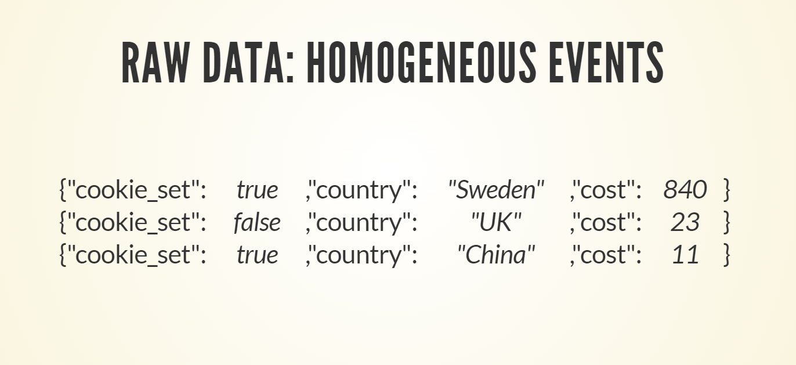
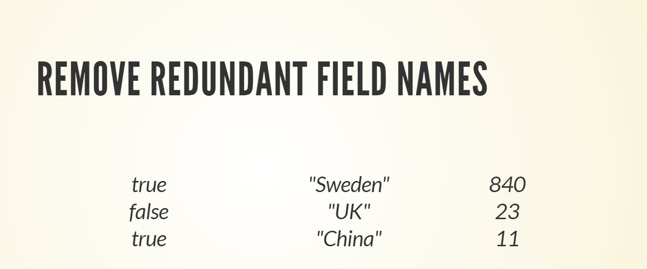

Slide 12
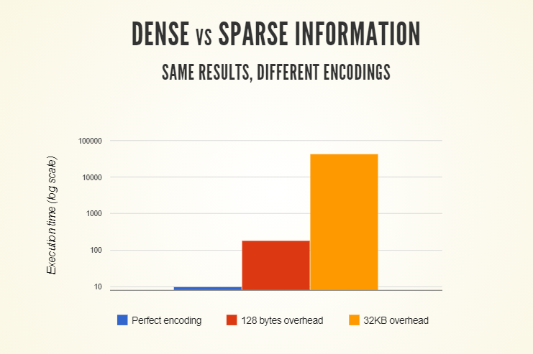

Slide 13
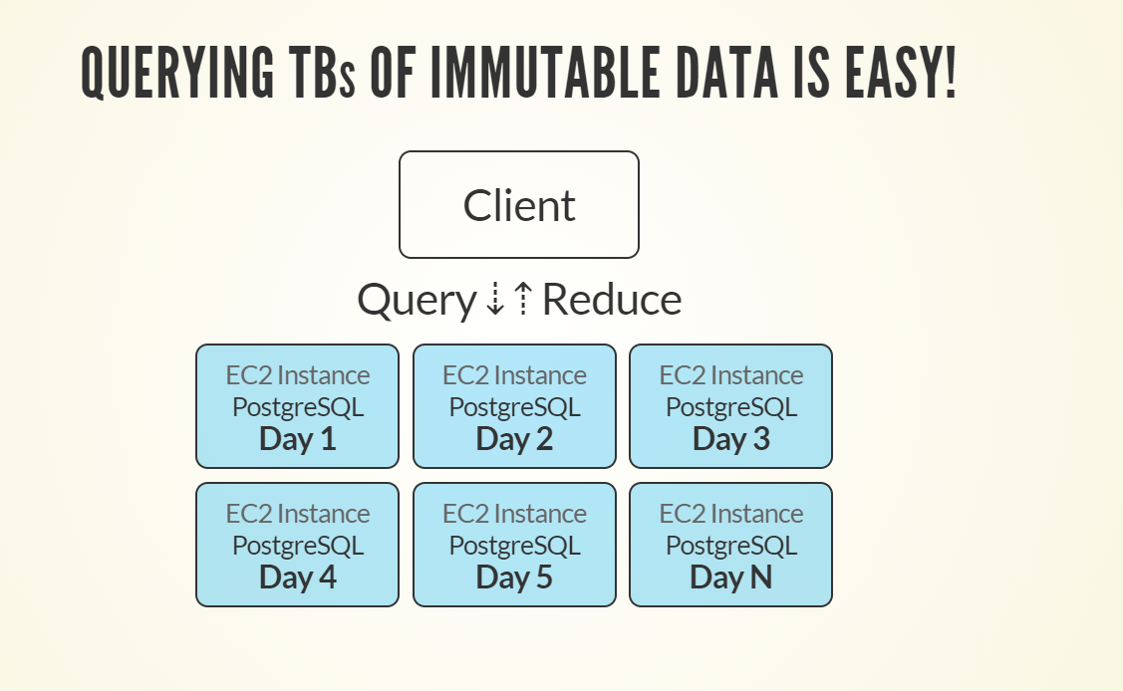

Slide 14
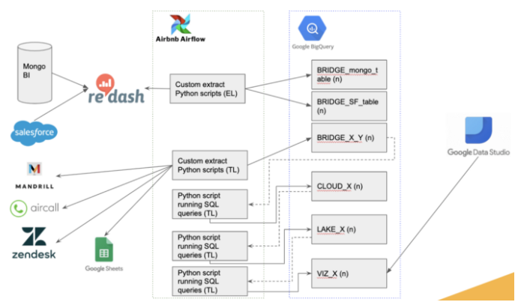
Use case

Slide 15
References
https://medium.com/everoad/building-a-data-warehouse-in-six-months-what-did-we-learn-e058e42446f1
https://medium.com/datadriveninvestor/complete-data-analytics-solution-using-etl-pipeline-in-python-edd6580de24b
https://tuulos.github.io/pydata-2014/#/
https://www.youtube.com/watch?v=xnfnv6WT1Ng&ab_channel=PyData
https://kubernetes.io/docs/home/
Notes:
https://medium.com/everoad/building-a-data-warehouse-in-six-months-what-did-we-learn-e058e42446f1

